Slide 1
Pre-Live Session
Forecasting

Slide 2
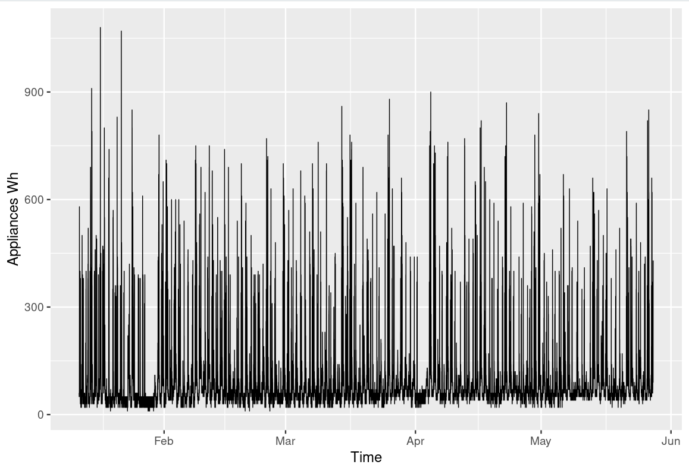
House Appliance in Wh

Slide 3
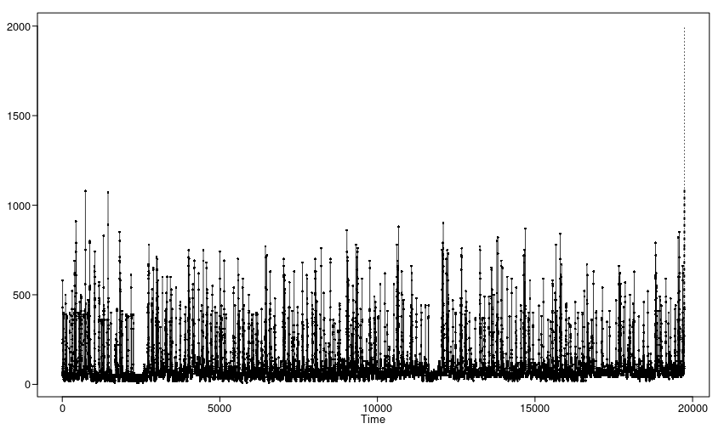
House Appliances energy Forecast
It seems like the Aruma(3,1,2) model would be best for this dataset. From the domain knowledge, this can be considered a seasonal dataset. The database =t was collected over 4 months which having a s = 4 makes the forecast make more sense. It seems like the higher I increased the s, the upward the forecast is.

Slide 4

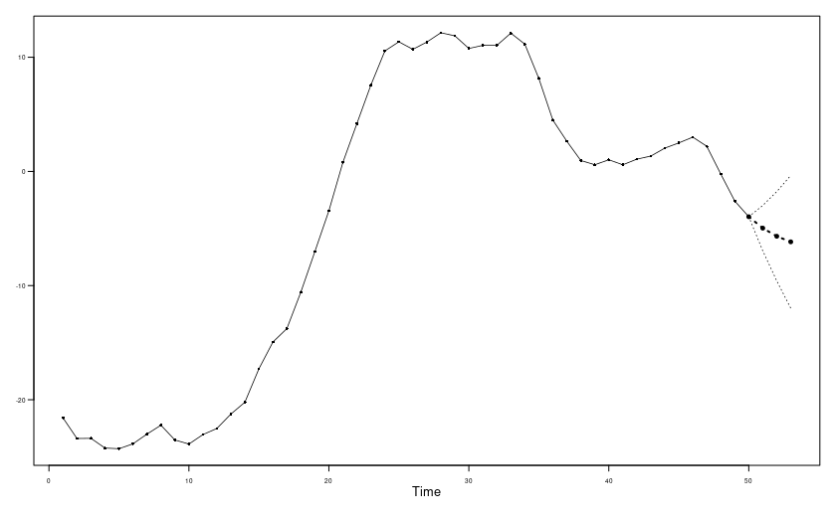
(1–.9B)(1–.8B)Xt = at
psi.weights.wge(phi=c(1.7,-.72), lag.max = 5)
x = gen.aruma.wge(n=50, phi=c(1.7,-.72), sn = 15)
fore.arma.wge(x, phi=c(1.7,-.72),n.ahead = 3, limits = T)

Slide 5
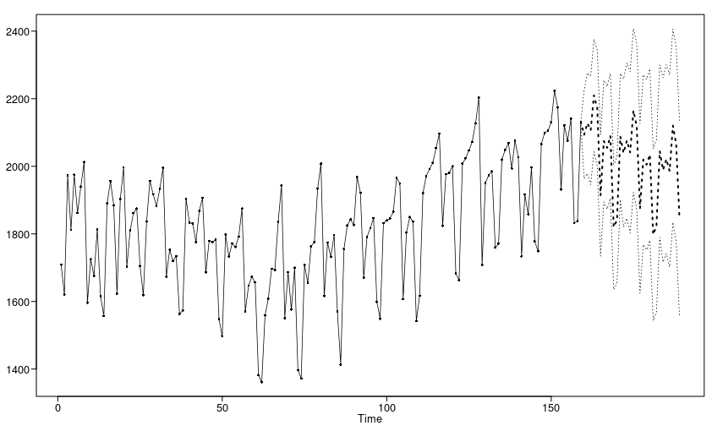
Amtrak Data Model 1 (Best Model)

Slide 6
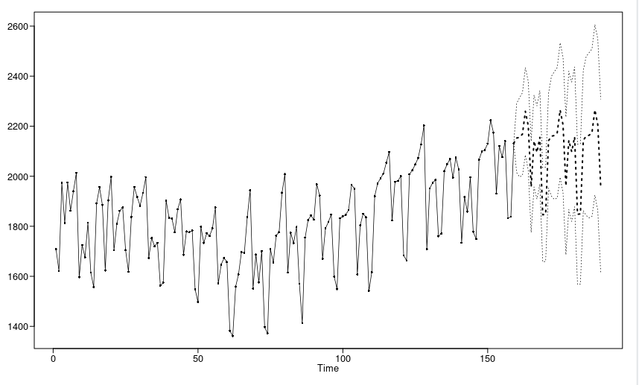
Amtrak Data Model 2

Slide 7
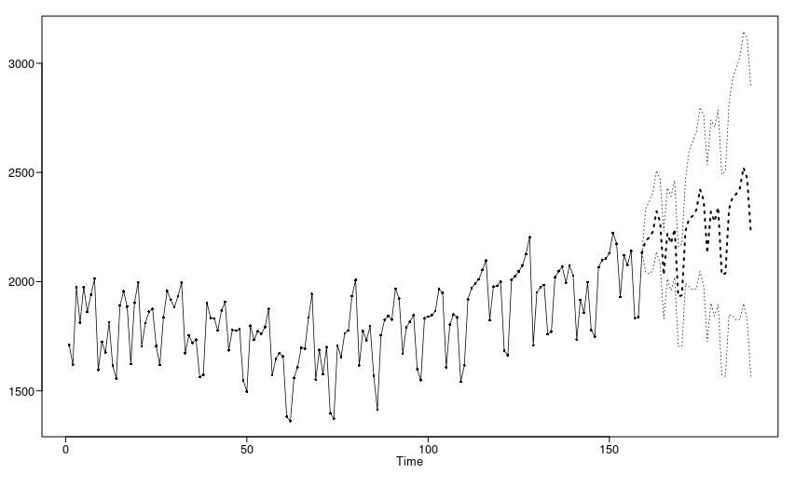
Amtrak Data Model 3

Slide 8
Takeaways
ARIMA forecasts whatever the d determines the direction of the forecast.
Forecast of stationary model always converges to the mean. AR(1) converges without going over the mean. AR(2) and AR(p) can cross the mean but eventually converges to the mean.
ARMA models also converges to the mean. The MA part affects the forcasts, and the eventual forecasts behave in much the same way as they would for the AR part of the model.

